Slide 1
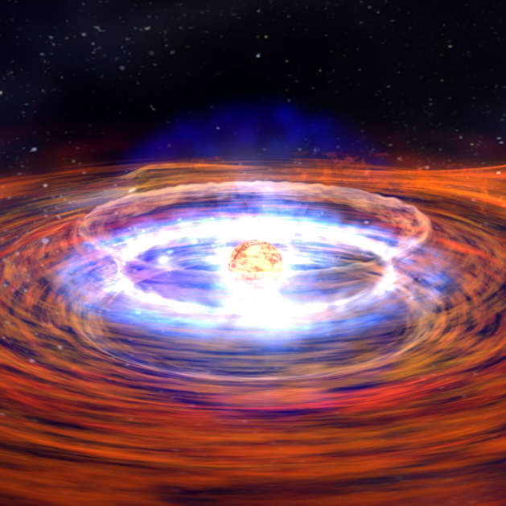
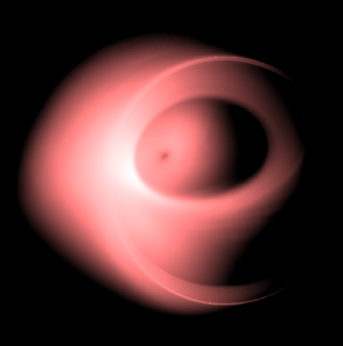
Sgr A*: a window into low-luminosity AGNs
BH shadow
conduction
Credit: NASA/Dana Berry
Roman Shcherbakov
PhD colloquium
27 Apr 2011

Slide 2
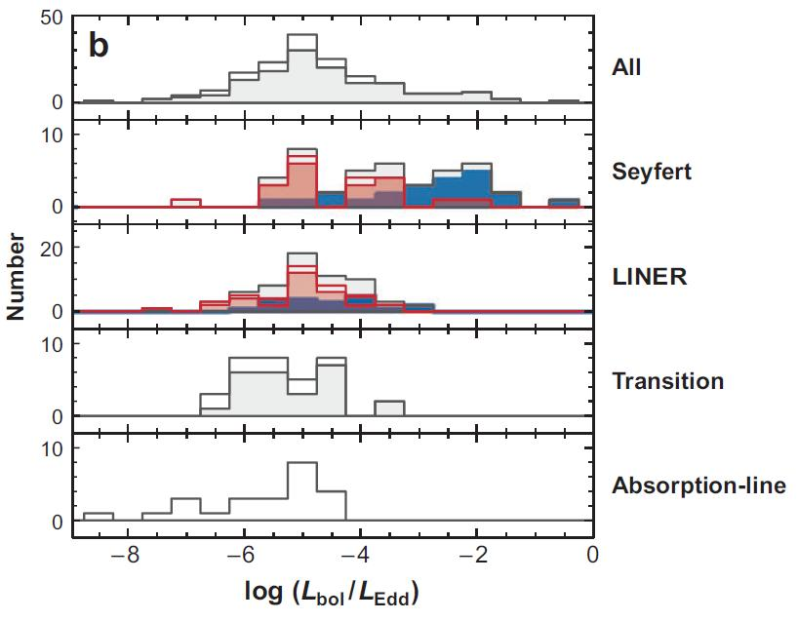
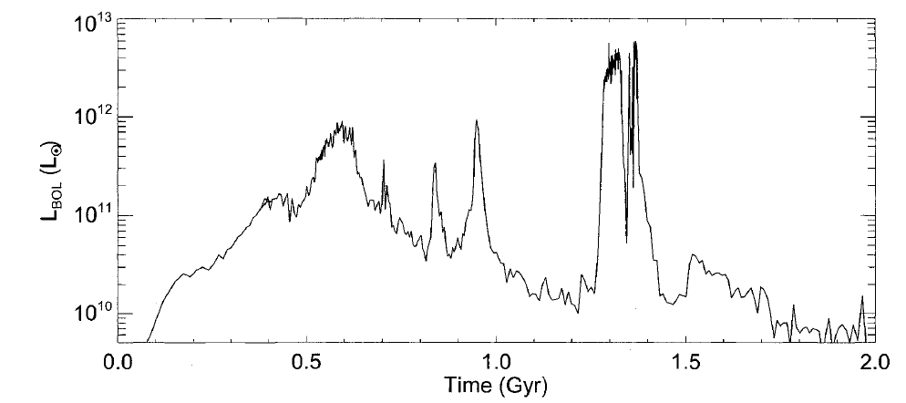
Typical AGN is not active
Sample of nearby galactic nuclei
Luminosity of a major galaxy merger
Hopkins 2008, thesis
Ho 2008, review
An AGN shines at Eddington luminosity
for only a short time
(mergers don’t happen all the time)
L_{bol} – total luminosity
L_{Edd} – Eddington luminosity
(theoretical maximum AGN luminosity)
Typical AGN has
L_{bol}/L_{edd}~10⁻⁵
lower L_{bol} objects may still be missed
Sgr A* has L_{bol}/L_{edd}~10⁻⁸
Notes:
Two Milky-Way galaxies merge, p.84 Hopkins thesis

Slide 3
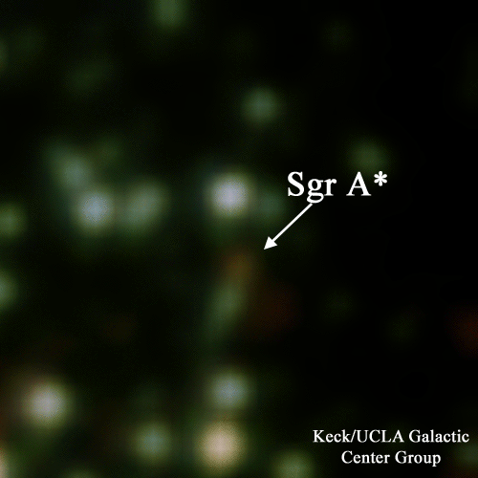


Galactic Center Black Hole Sgr A*
Closest to us – easier to study?
Not really
Discovered as a radio source
Balick & Brown 1974
Dramatically underluminous
Keck-UCLA
GC group
Narayan et al. 1998
Monitoring of stellar orbits
=> black hole inside
Ghez et al. 2008; Gillessen et al. 2009
vs
Notes:
Caltech Submillimeter Observatory (CSO), James Clerk Maxwell Telescope(JCMT), Submillimeter Array (SMA), Combined Array for Research in Millimeter-wave Astronomy (CARMA) – merged BIMA & OVRO, Nobeyama (includes NMA), Millimetric Radio Astronomy (IRAM), Very Large Array (VLA), Very Long Baseline Array (VLBA), Owens Valley Radio Observatory (OVRO), Berkeley Illinois Maryland Association (BIMA)

Slide 4
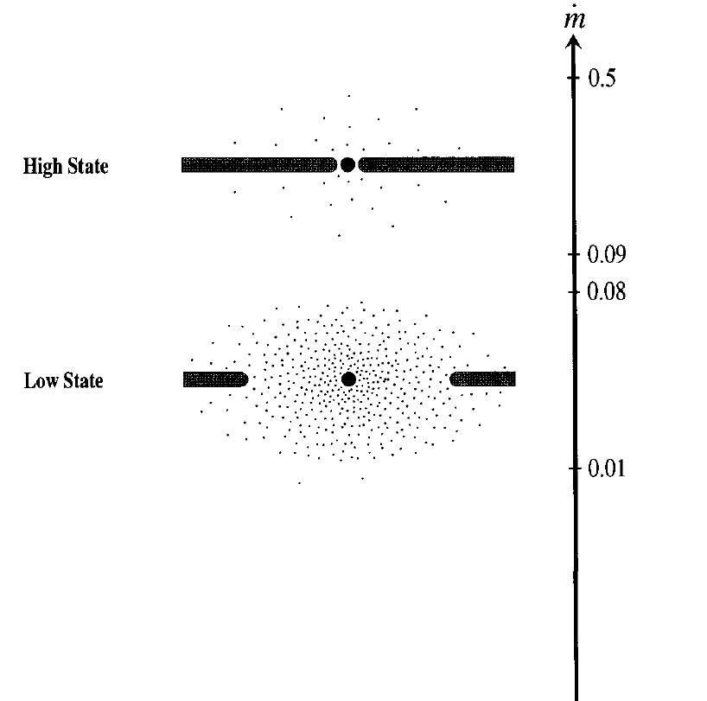
Physics vs accretion rate
Thin disk
Shakura & Sunyaev 1973
Esin, McClintock, Narayan 1998
Narayan, Yi 1994+
ADAF
Advection-dominated
accretion flow
Other effects/flow types
Low density, high T plasma
Large mean free path
Conduction
Johnson, Quataert 2007
Real galactic nuclei have
L_{bol}/L_{edd}~10⁻⁵ => low
Sgr A* has L_{bol}/L_{edd}~10⁻⁸
=L_{bol}/L_{Edd}

Slide 5
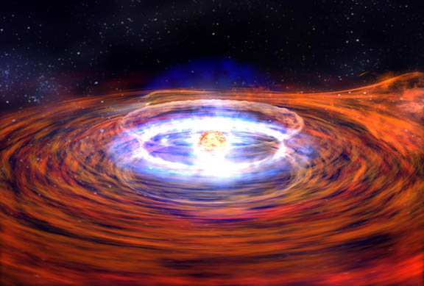
How does conduction work?
Equilibrates Te
The binding energy of a gram of gas at a few r_{g} drives off 100 kg of gas from 10⁵ r_{g}
Blandford & Begelman 1999
Now we know how!
r_{g}=G M/c² – characteristic BH size
Conductive heat flux
Unbinds
the outer flow
Original: NASA/Dana Berry
In magnetized flow:
conduction is damped 3-5 times
Theory
Narayan & Medvedev 2001
Simulations
Ruszkowski & Oh 2010
Electrons can jump from one field line to another
Large e⁻ mean free path near Sgr A*
Electron conduction dominates convection etc.
Damped by a factor of 3~5 in tangled magnetic fields

Slide 6
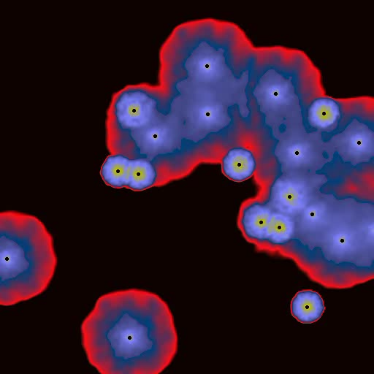
Feeding by stellar winds
Cuadra et al 2005+
Sgr A*
Stars emit wind at 300 – 1200km/s
ejection rate
Winds collide, heat the gas,
provide seed magnetic field
Gas is there. Does it accrete?
Most of gas flows out,
some accretes
~10’’=0.4pc
Typical for local AGNs:
Kauffman, Heckman, 2009

Slide 7
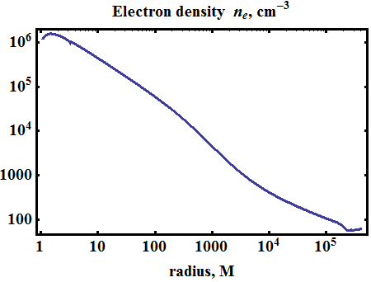
Model w/ conduction & stellar winds (1D)
Solve 1D conservation equations modified by
conduction w/ heat flux
matter/energy input from stellar winds
ADAF
Inflow
Outflow
Heat flux Q
r/r_{g}, distance from center
r_{g}=G M/c² – characteristic BH size
Shcherbakov & Baganoff 2010

Slide 8
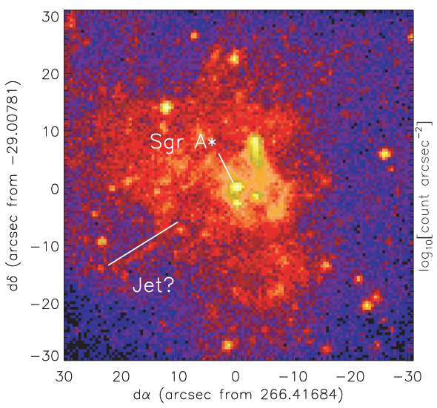
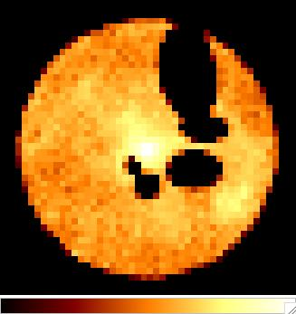
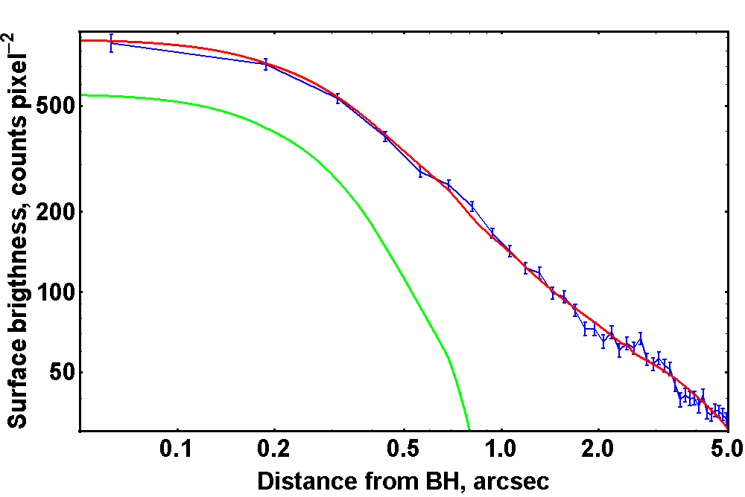
Fitting X-rays
Chandra view of Sgr A*
Muno et al. 2008
blue – quiescent observations
red – model convolved w/ PSF
X-rays from hot gas/no point sources
Shcherbakov & Baganoff 2010
Reproduce
surface brightness profile
green – point source = PSF

Slide 9
Conclusions of Part 1
Most AGNs are in extremely underluminous state
New models/effects are needed to explain them
Conduction is a promising candidate – works for Sgr A*
“More self-consistent” models – future work
Application to other low-luminosity AGNs (~20)
Future work

Slide 10
Part 2.
Modeling LLAGN inner flow –
BH spin

Slide 11
Techniques to Find BH spin
Black hole accretion
Radiatively efficient (thin disk)
Radiatively inefficient (RIAF)
most AGNs
X-ray continuum
Iron line
Polarization of X-ray continuum
Inference from jet power
McClintock, Narayan,
Steiner, Gou etc.
controversial
Daly 2008+
Sub-mm polarized continuum
Fabian, Reynolds etc.
future
Li, Schnittman, Krolik etc.
Hot rarefied plasma T_{e} ~10¹⁰⁻¹¹K (relativistic)
Emits radio/sub-mm near (?) the event horizon
Radiation is polarized + inverse Compton upscattered
Emission/transfer modulated by GR effects
Spectral fitting gives inclination θ, spin a*

Slide 12
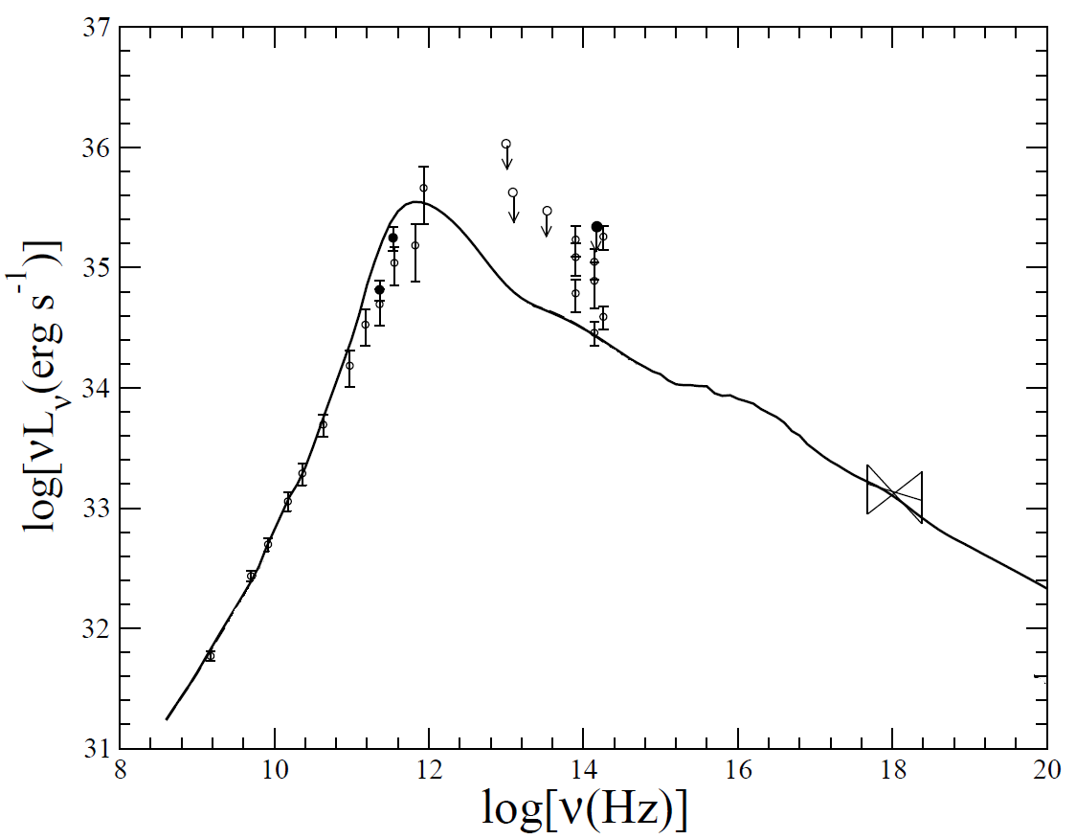
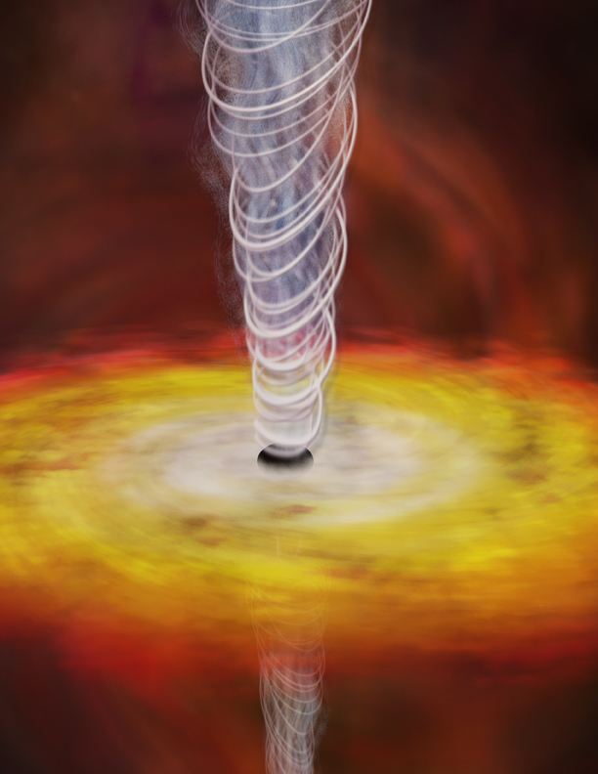
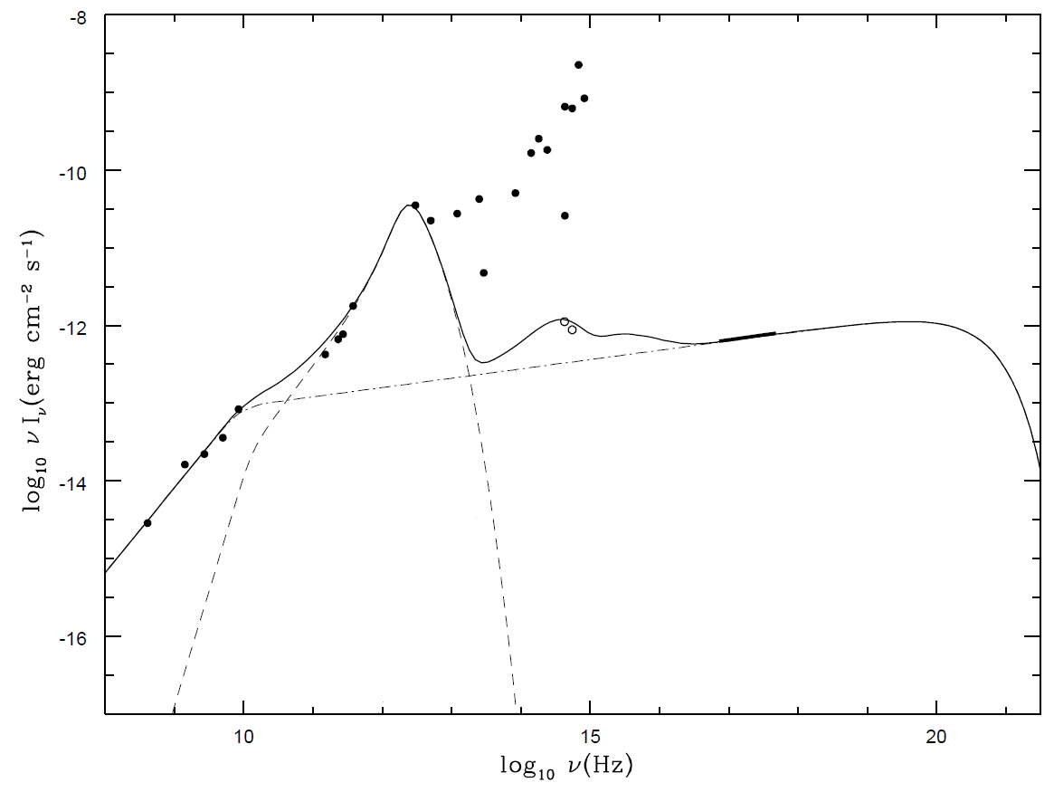
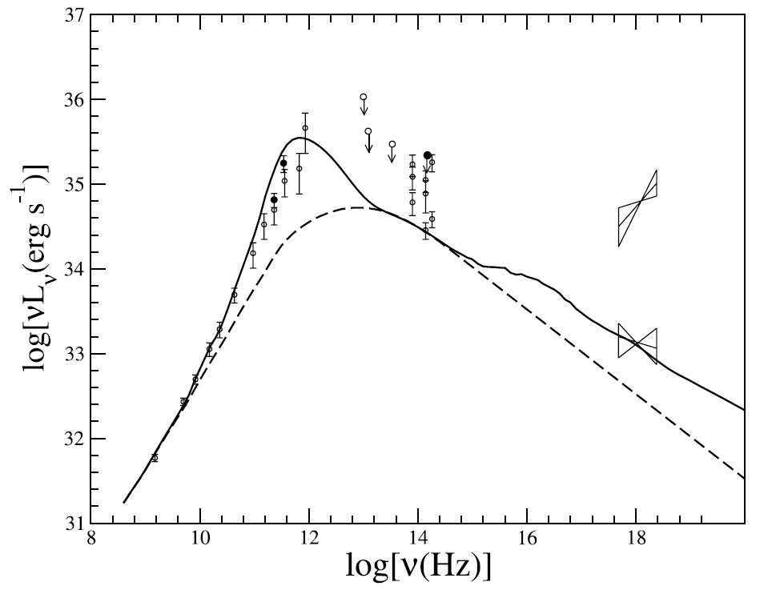
Radiation from inefficient BH accretion
Sgr A*
extended emission
+ Compton-scattered (SSC)
Yuan et al. 2003
cyclo-synchrotron
near event horizon
Jet emission
jet/non-thermal
polarized (sub-)mm is coming from near the horizon
Yuan et al. 2004
Comptonized
IR, X-Rays
cyclo-synchrotron
near event horizon
jet
Sub-mm
X-rays
IC 1459
Fabbiano et al. 2003
credit: NASA
X-Rays
1Ms of Chandra obs.
IR
Hubble, Keck
sub-mm + radio
CARMA, VLBA, SMA etc; polarization data

Slide 13
How to extract a* (spin value)
Observations
Dynamical model of the flow
GR polarized
radiative transfer
Statistical analysis
Spin a*, inclination θ,
electron temperature T_{e}, accretion rate M_{dot}
For the particular dynamical model

Slide 14
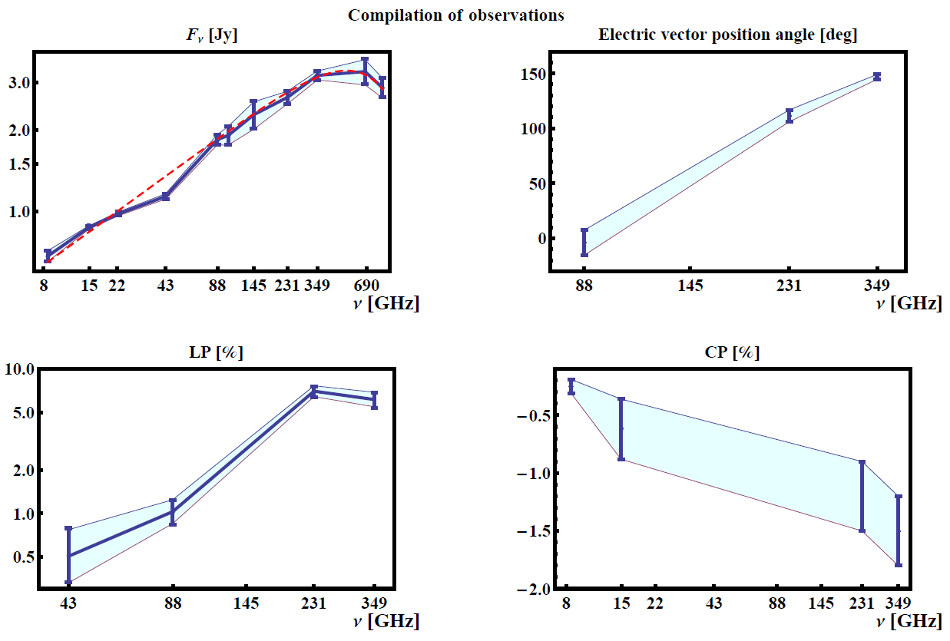
Mean radio/sub-mm spectrum (Sgr A*)
Means and standard errors in sub-mm (all observations)
Keck-UCLA
GC group
(animation)
We fit: F_{ν}(87-857GHz) – 7 points; LP(87,230,349GHz); CP (230,349GHz)
All consistent with Gaussian distributions (K-S test) => χ² analysis justified
Green – old compilation, based on only 5 papers

Slide 15
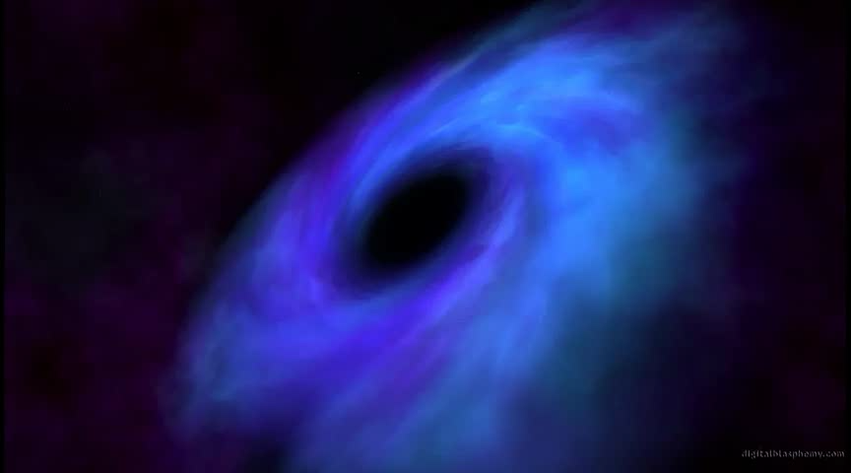
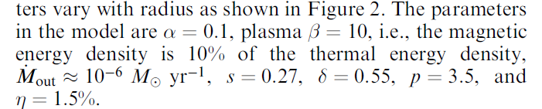
Dynamical model
Ideal model: no free parameters, correct GR with spin a*
treats distribution of electrons
© digitalblasphemy.com
Simulations =>
decrease N of free parameters +
eliminate assumptions
Models based on simulations
Moscibrodzka, et al. 2009
Dexter, Agol, Fragile 2009
Analytic models
Shcherbakov, Penna, McKinney, 2010, subm
Yuan, Quataert, Narayan 2003
2 flow parameters + 2 for BH
Huang, Takahashi, Shen 2009
Broderick et al. 2009+
Assumed magnetic field
structure and strength
Approximations in flow structure
Reliable flow/magnetic field structure
Need to converge
Still long way to go to incorporate all effects

Slide 16
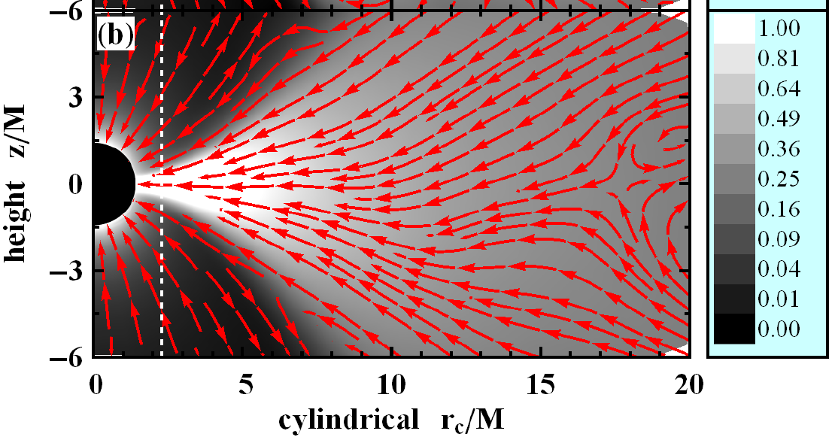
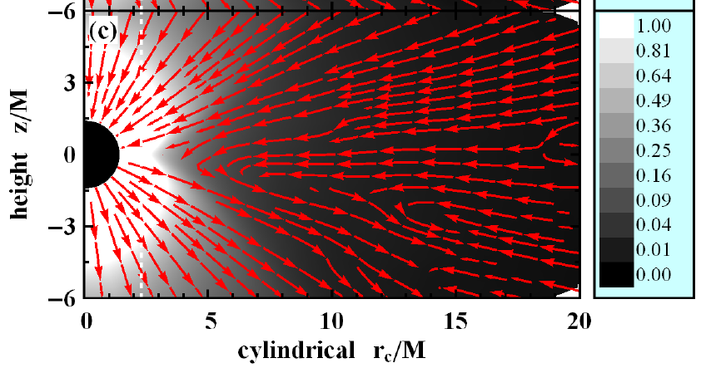
3D GRMHD simulations
Similar setups besides changing spin a*
velocity + density
Simulate a set of spins
a*=0; 0.5; 0.7; 0.9; 0.98
Evolve for ~40 orbital periods
at 25r_{g} radius (flow settles)
Use averaged profile
at late simulation times
for radiative transfer
z/r_{g}
r/r_{g}
magnetic field + its energy density
Magnetic field settles by into helix
(split monopole in projection)
z/r_{g}
r/r_{g}

Slide 17
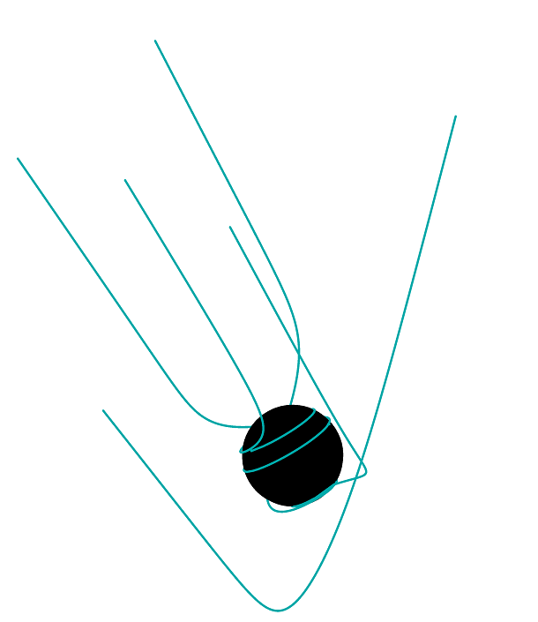
GR polarized radiative transfer
Ray tracing
Procedure is outlined in
Shcherbakov, Huang 2010
Propagation effects of
polarized radiation
Shcherbakov 2008
Implemented (by me) in C++,
run on a supercomputer
Application to Sgr A* in
Shcherbakov, Penna, McKinney 2010,
ApJ, subm, arXiv:1007.4832

Slide 18
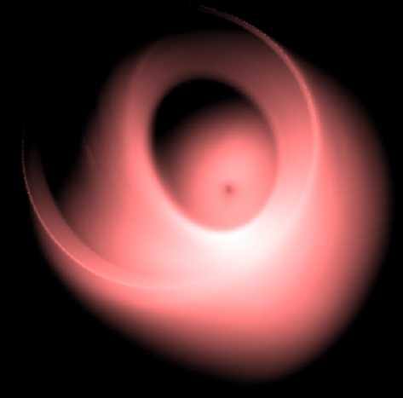
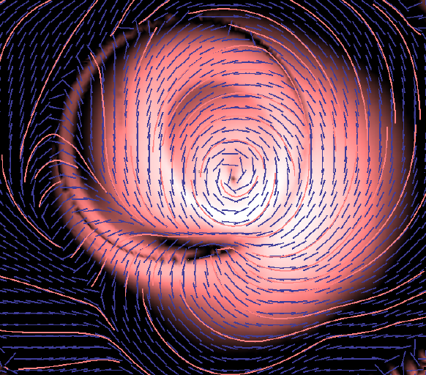
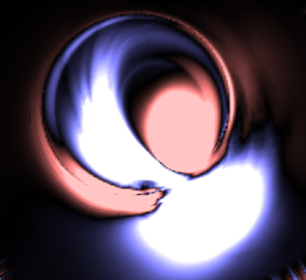
Polarization => 4x information
No polarization info
Full polarization info
I
LP
CP
I – total intensity
+ linear polarization (LP)
+ circular polarization (CP)
+ electric vector position angle (EVPA)

Slide 19
Statistical analysis
Step 1
Find mean SED & standard errors to define the spectrum
Step 2
Prove normal distribution of observations (K-S test)
Step 3
Do χ² statistics
Step 4
In the space of Tp/Te, Mdot, a, θ
find regions with χ²/dof→1 => there are good models!
Step 5
Find confidence intervals, constraints

Slide 20
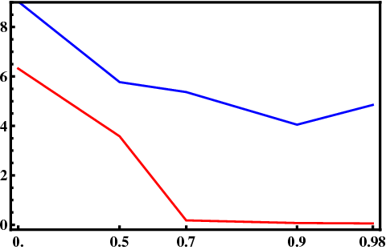
Which spin is better?
Lowest χ²/dof as a function of spin a*
χ² for full polariz. info
Min reduced χ²/dof
χ² for flux spectrum
spin a*
Weak constraints from flux fitting
Best spin is a*=0.9
Must use polarization to find spin
Most probable model: χ²/dof=4,
spin a*=0.9,
inclination θ=52°, Te~5·10¹⁰K
accretion rate Mdot=1∙10⁻⁸M_{sun}/year
χ² (a=0) too high => excluded
More work needed
to reliably find spin

Slide 21
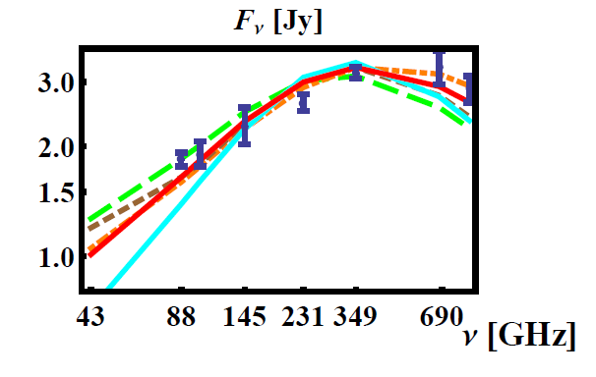
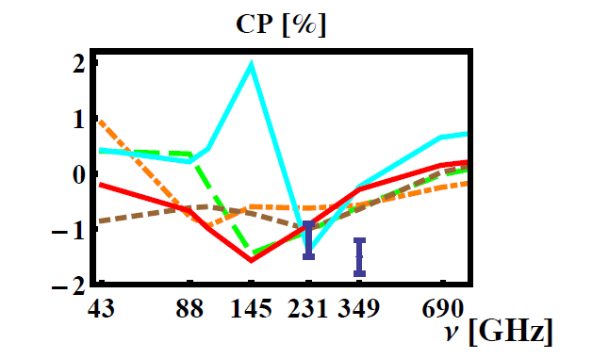
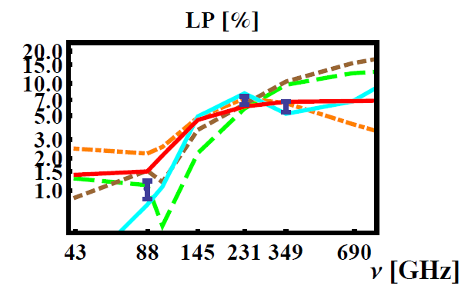
Best fits to observations
Best model has spin a*=0.9 (χ²/dof=4)
– red solid curve
Best models for spins 0, 0.5, 0.7, 0.9, 0.98 are shown

Slide 22
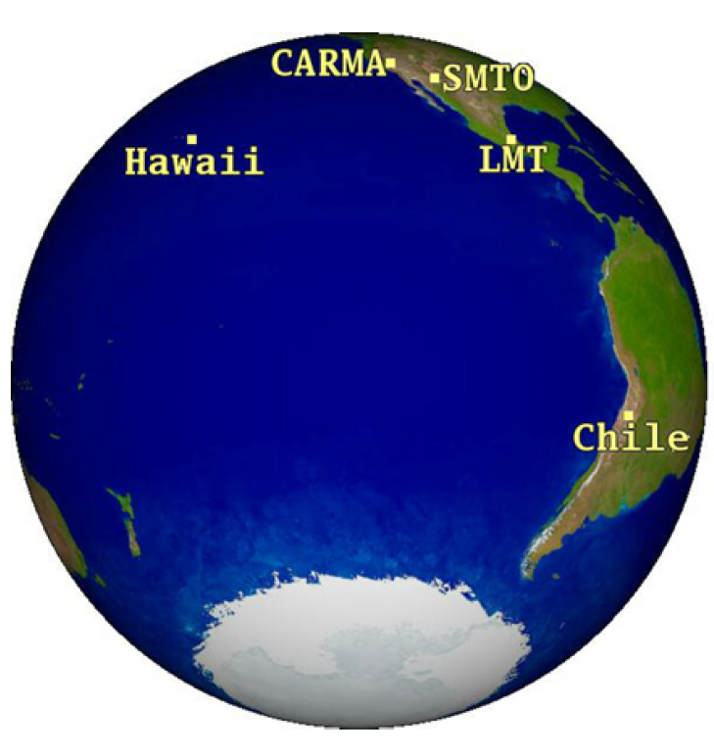
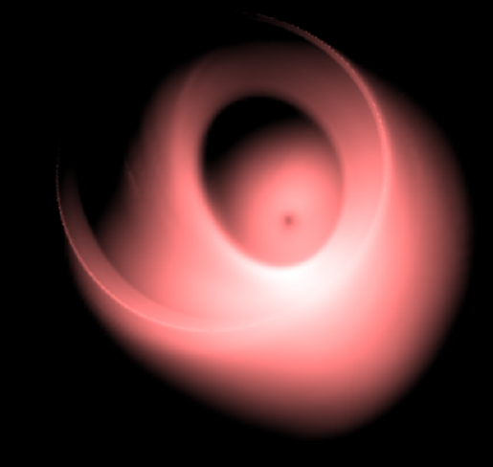
Imaging BH horizon
Very Long Baseline Interferometry (VLBI)
37μas at 230GHz on Hawaii-Arizona baseline
Doeleman et al. 2008
Possible to resolve horizon-scale structure
Flow is inconsistent w/ spherical accretion
37μas
More stations and baselines in next ~5 years
Visibility (size) for the best a*=0.9 model
is consistent with VLBI observations
Map & reconstruct the entire image!
New data: Fish et al. 2011 +
new observations are being reduced
Directly observe BH shadow
Notes:
JCMT – Hawaii, CARMA – California, SMT – Arizona
SMT – JCMT(Arizona - Hawaii) – first detection

Slide 23
Comparison with previous estimates
Paper | model Type | N of frequencies | Polar. data | Size | X-rays | Best spin | Inclination
Broderick et al. 2009+ | analytic | 10 | no | Yes | No | 0 | 48-73
Huang et al. 2009+ | analytic | 4 | Yes, LP | No | No | <0.9 | 40, 45
Moscibrodzka et al. 2009 | 2D GRMHD | 3 (1 in X-rays) | no | Yes | Yes | 0.9 | 45
Dexter et al. 2009+ | 3D GRMHD | 1 | no | Yes | No | 0.9 | 35-85
Shcherbakov et al. 2010 | 3D GRMHD | 7 | Yes, CP+LP | No, found consistent | No | 0.9 | 50-59
Accretion rate ~1∙10⁻⁸M_{sun}/yr
agrees with
Mdot ~ 6∙10⁻⁸M_{sun}/yr
from model of outer flow
w/ conduction
Models with more physics,
which fit all types of observations

Slide 24
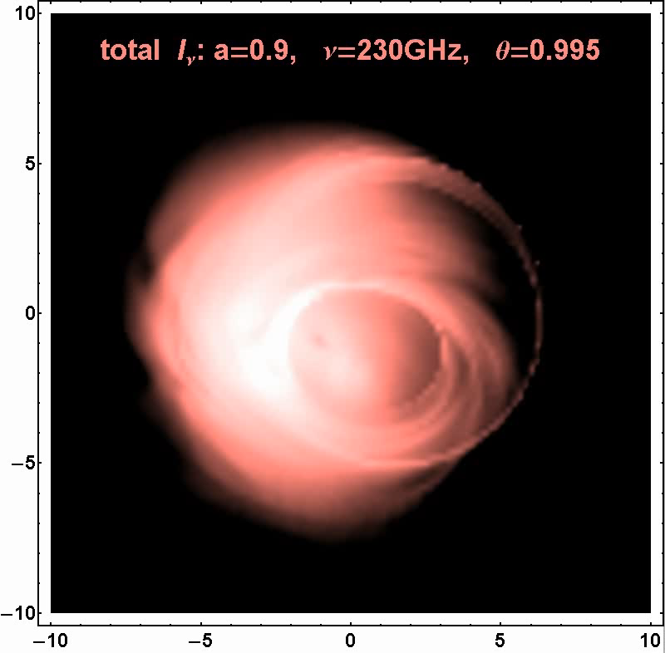
LLAGNs: other objects/new techniques
Sgr A*
polarimetric imaging
with VLBI
Doeleman et al. 2008, Nature
Fitting X-ray inverse Compton (IC) flux
L_{X, IC}≈4·10³²erg/s
Shcherbakov, Baganoff, 2010
M31*
Analysis of variability
Li, Garcia 2005+
Let me know if you have a good source to model!

Slide 25
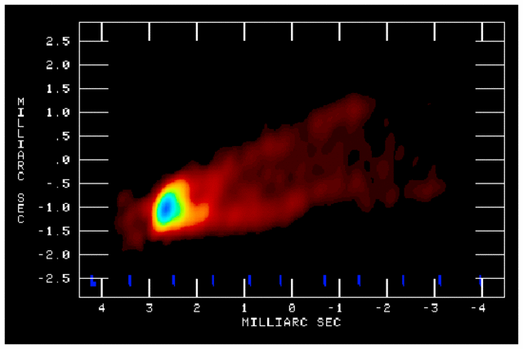
Jets: other objects/new techniques
M87
+ polarimetric imaging
with VLBI
3C279
Walker et al. 2008
Full polarization spectrum available
Radiation may come from 10M (Blandford)
Homan et al. 2009; Abdo et al. 2010, Nature
Let me know if you have a good source to model!

Slide 26
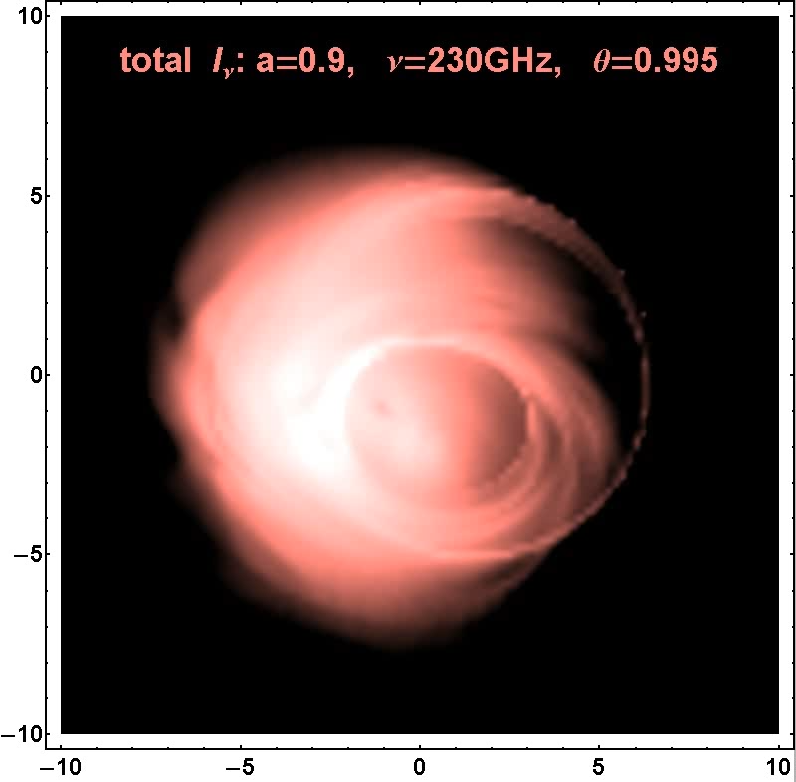
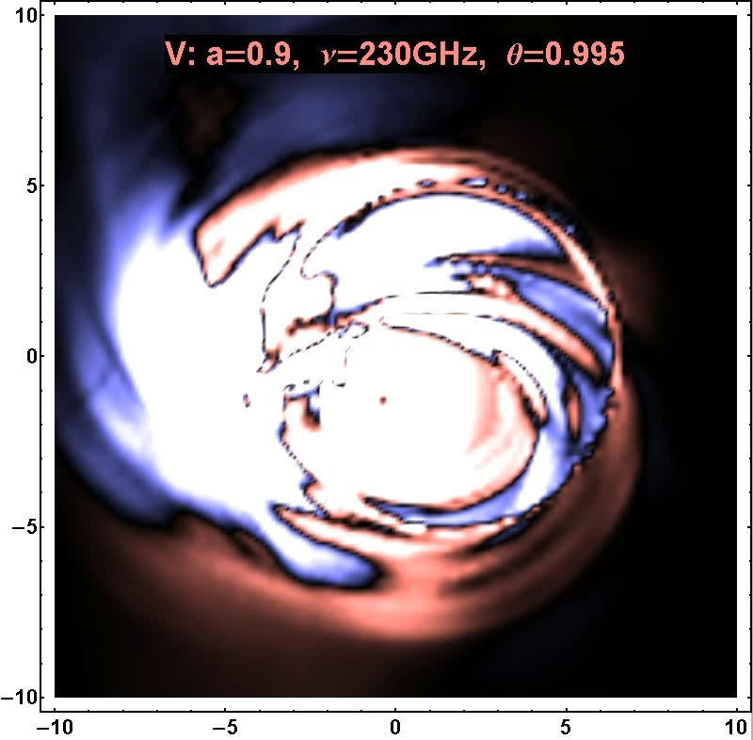
Movies
Total intensity
Circular polarized intensity
Distances in units of r_{g}

Slide 27
Conclusions
Developed & implemented original model of accretion w/ conduction
Developed & implemented simulation-based model in Kerr metric
Formulated & implemented GR polarized radiative transfer
Compiled observed spectrum of Sgr A* & applied rigorous statistics
Reconciled matter supply & demand for Sgr A*
Found n~r^{-0.9} profile between inner and outer Sgr A* flow
Achieved fit to sub-mm spectrum, LP & CP fractions, size
Constrained Sgr A* spin value & accretion flow properties
Future work
Refine model with conduction & simulation-based model for inner flow
Improve radiative transfer (add Comptonization)
Apply to other LLAGNs & jets (M87, M31, M81, 3C 279, IC 1459, Fornax A)
2 papers/day on astro-ph

